Slide 1


House Price Analysis in King County, USA
Partners
Shreeniket Subhash Deshmukh
Shakya Ashok Munghate

Slide 2

Agenda
Problem Statement
House Sales Data
Approach Towards Analysis
Descriptive Statistics
Results
References
Data Cleaning

Slide 3
Problem Statement
One of the very important considerations while buying a house is the valuation of the house after some years from now.
How would a Real-Estate company decide the current sale price of a new apartment?
Housing price is not just dependent on what locality it belongs to. There are more factors responsible for this dynamic pricing.
In this project, we evaluate the statistical relationships between the different independent variables and the housing price and design a model which can predict the sale price of a property based on these variables.

Slide 4
House Sales Data
Data is of house sales in King County, USA. King County includes Seattle which is largest city in States
This data is about house prices from May 2014 to May 2015
Source: Kaggle
Data contains 21613 Observations and 21 Variables
Variables: House ID, Price and 19 more house features

Slide 5
Approach Towards Analysis
Data Cleaning
Exploratory Data Analysis (EDA)
Statistical Data Analysis
Modeling

Slide 6
Approach Towards Analysis
Performed data cleaning and exploratory data analysis of properties in King County, USA
Performed the analysis of change in house sales price based on number of bedrooms, house size, location, year built, etc.
Displayed the data on Maps based on house price and house size
Performed Correlation Analysis and checked the relationship between the variables
Used Linear Model, Random Forest and LASSO in order to make predictions of the house price and also compared the accuracy of each model

Slide 7
Data Cleaning
Duplicate Columns Removed
NA Values Removed
Date Column is in “YYYYMMDDT000000” format. It is converted into “YYYY-MM-DD”

Slide 8
Descriptive Statistics
 | Price | Bedrooms | Bathrooms | Area (sqft)
Mean | 540088.14 | 3.37 | 2.11 | 2079.9
Std.Dev | 367127.2 | 0.93 | 0.77 | 918.44
Min | 75000 | 0 | 0 | 290
Median | 450000 | 3 | 2.25 | 1910
Max | 7700000 | 33 | 8 | 13540

Slide 9
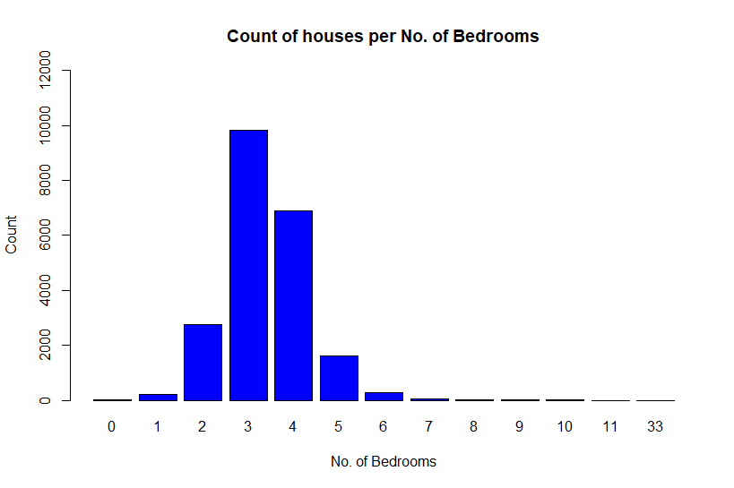
House Count

Slide 10
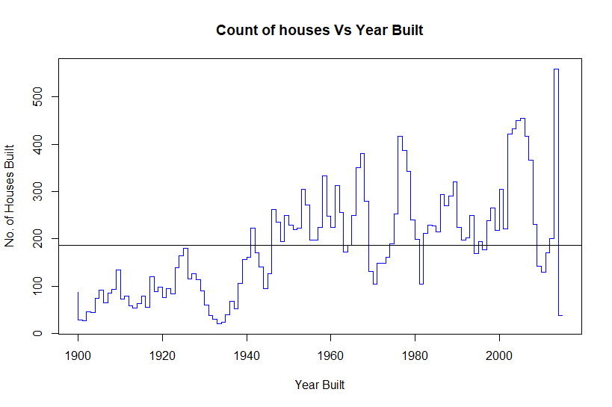
YoY House Count

Slide 11
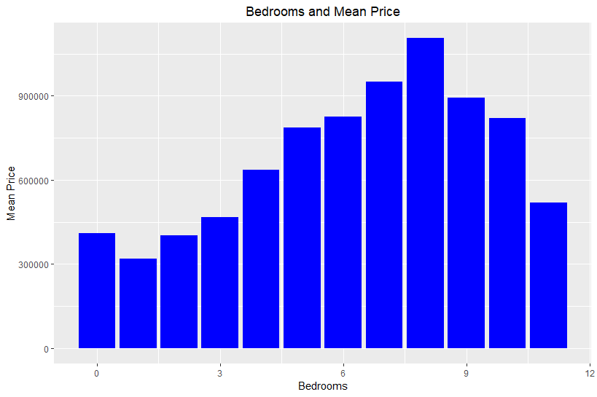
Bar plot: Mean Price

Slide 12
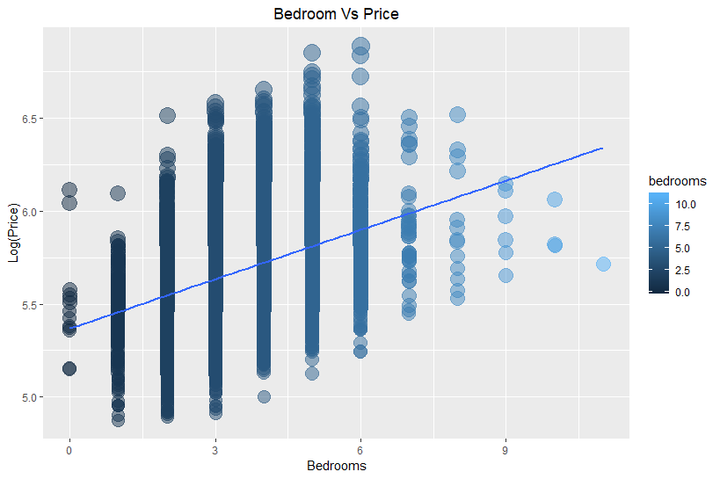
Bedroom vs Price
R = 0.35, p value almost 0

Slide 13
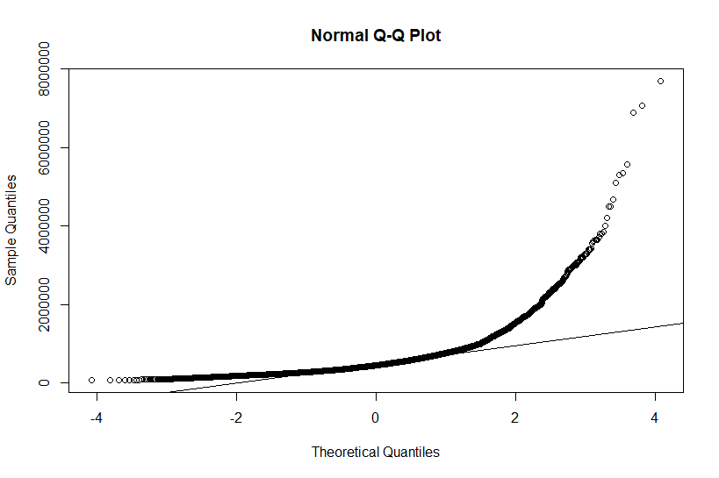
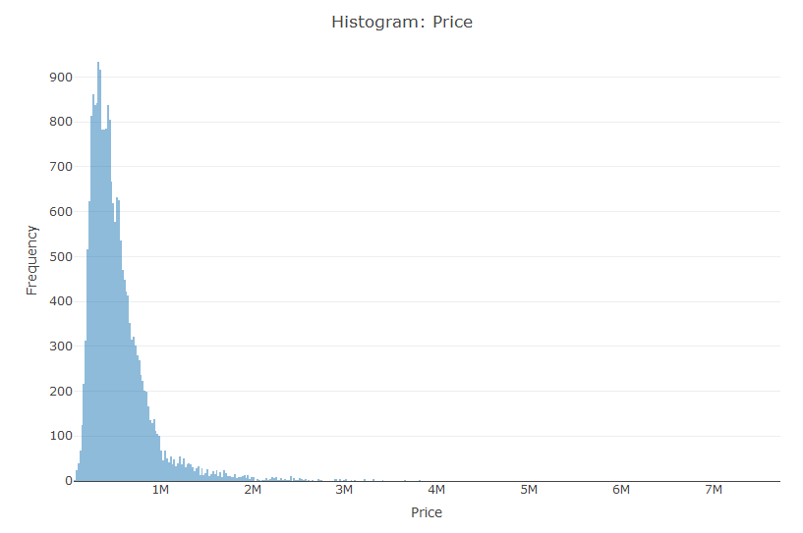
House Price Distribution

Slide 14
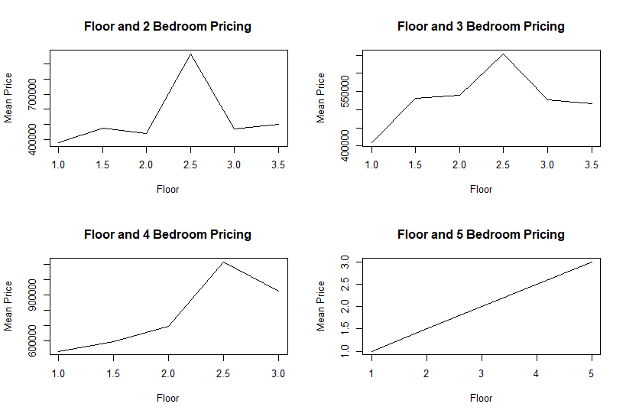
House Price Trend

Slide 15
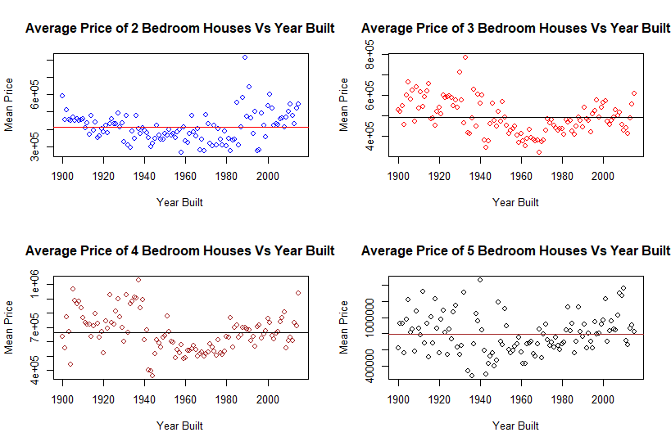
House Price Trend

Slide 16
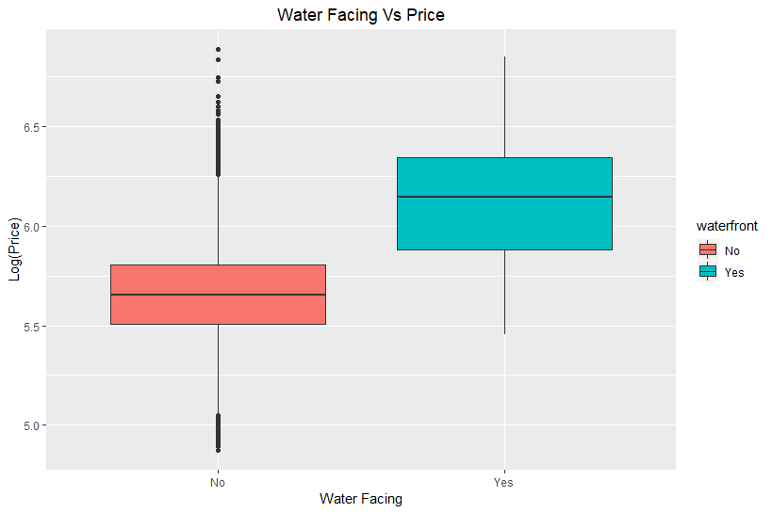
Boxplot: Water Facing Price

Slide 17
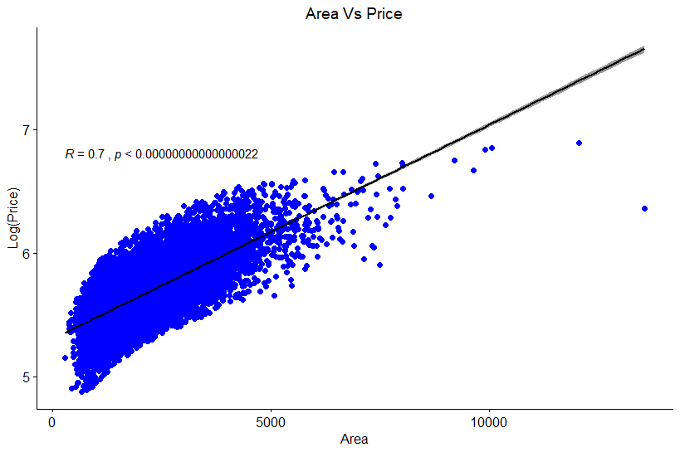
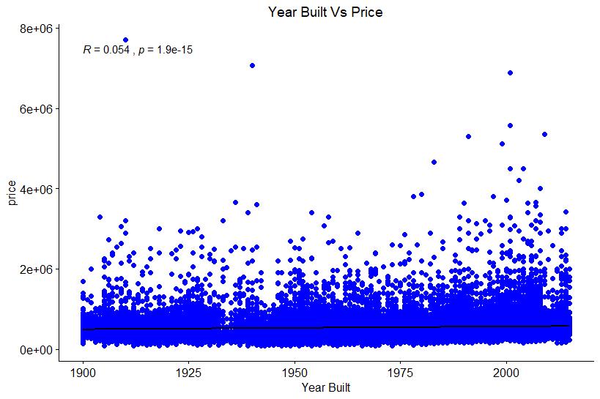
Scatter Plot: Price

Slide 18
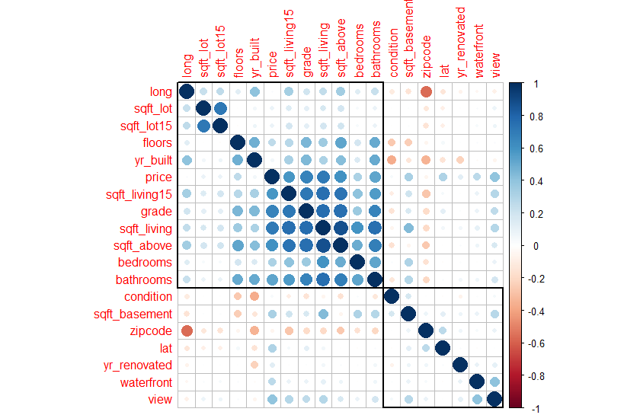
Correlation Plot

Slide 19
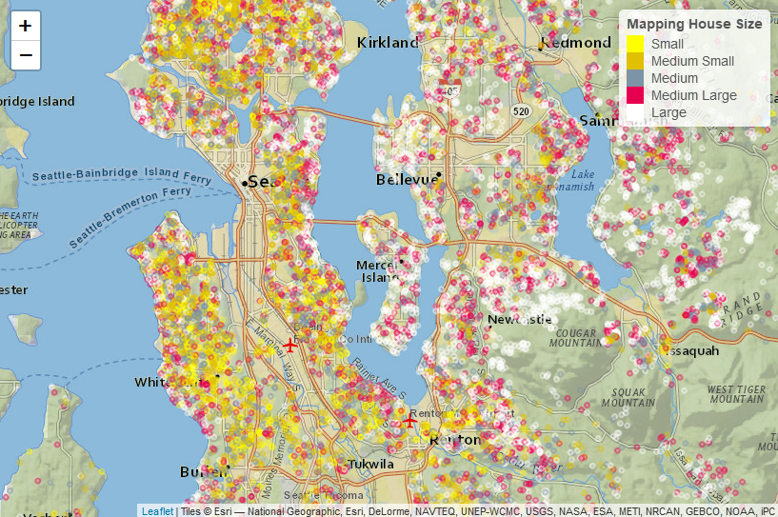
Mapping Size

Slide 20
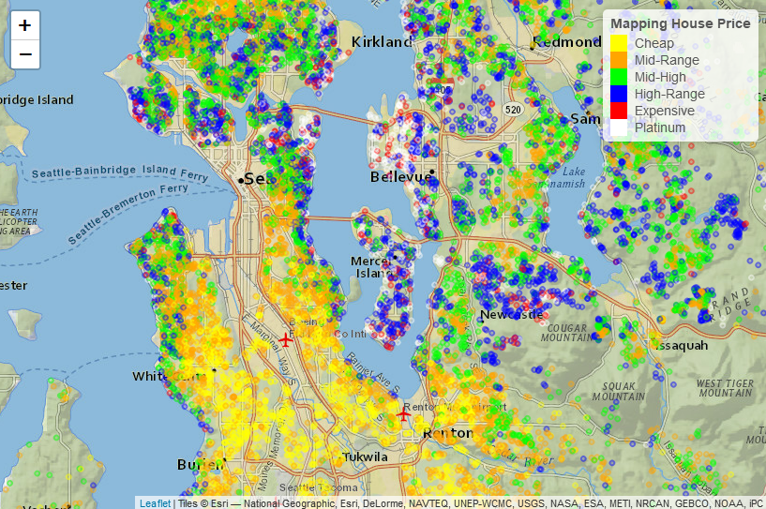
Mapping Price

Slide 21
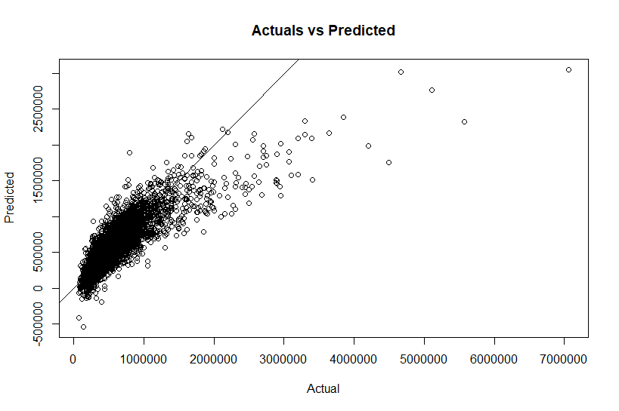
Linear Model

Slide 22
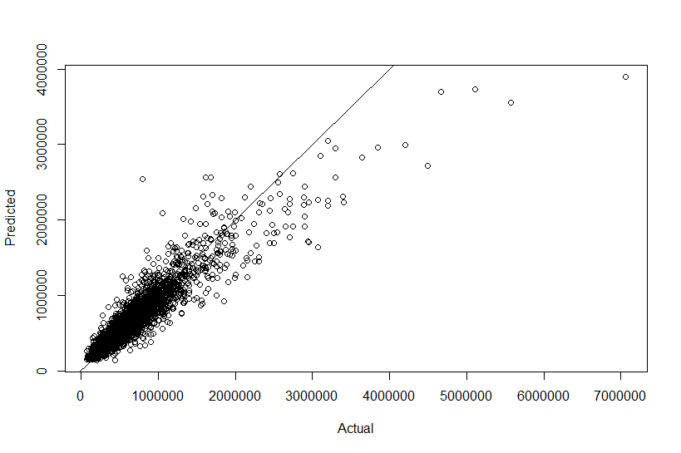
Random Forest

Slide 23
LASSO

Slide 24
RMSE
Regression | RMSE
Linear Model | 206297.9
Random Forest | 136519.3
LASSO | 206457.5

Slide 25
References
House Sales in King County, USA. (2019). Kaggle.com. Retrieved 14 February 2019, from https://www.kaggle.com/harlfoxem/housesalesprediction
An Introduction to corrplot Package. (2019). Cran.r-project.org. Retrieved 14 February 2019, from https://cran.r-project.org/web/packages/corrplot/vignettes/corrplot-intro.html
The Random Forest Algorithm – Towards Data Science. (2018). Towards Data Science. Retrieved 14 February 2019, from https://towardsdatascience.com/the-random-forest-algorithm-d457d499ffcd
Analytics, B., & A comprehensive beginners guide for Linear, R. (2017). A comprehensive beginners guide for Linear, Ridge and Lasso Regression. Analytics Vidhya. Retrieved 14 February 2019, from https://www.analyticsvidhya.com/blog/2017/06/a-comprehensive-guide-for-linear-ridge-and-lasso-regression/

Slide 26

Thank you

